Slide 1
Thevenin’s Theorem
Section 4.5
Md. Shafqat Talukder Rakin
Lecturer, Department of CSE,
United International University
Email id : shafqat@cse.uiu.ac.bd

Slide 2
Why Thevenin’s theorem
It often occurs in practice that a particular element in a circuit is variable (usually called the load) while other elements are fixed
Example:
A household outlet terminal may be connected to different appliances constituting a variable load. Each time the variable element is changed, the entire circuit has to be analyzed all over again
Should we recalculate each time the variable load changes?

Slide 3


Slide 4
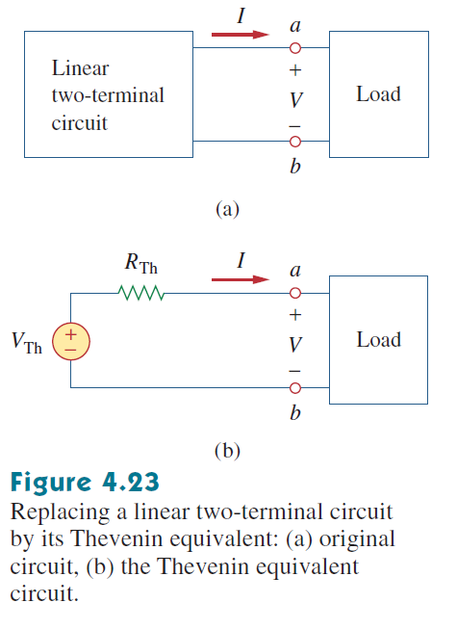
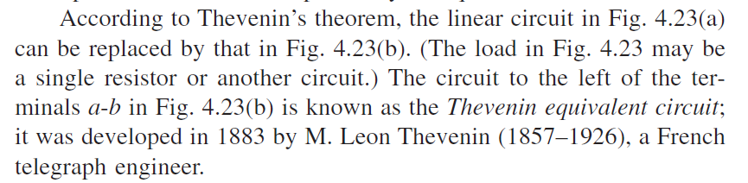
Thevenin’s technique

Slide 5
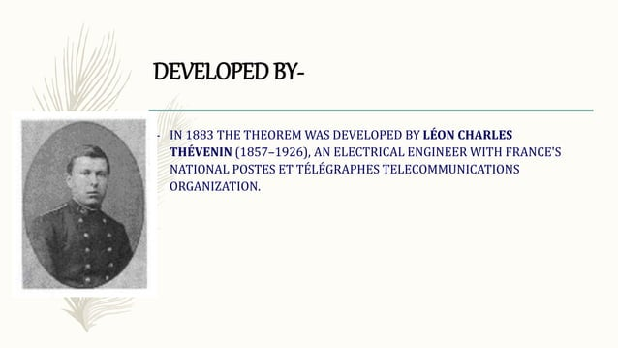

Slide 6
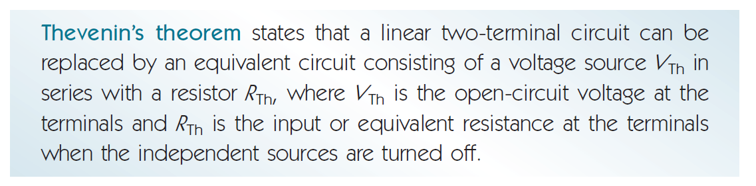
Thevenin’s theorem

Slide 7
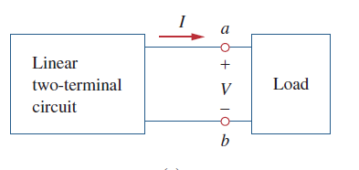
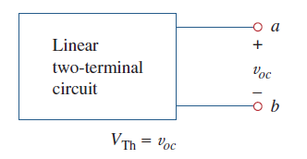

Steps for thevenin
STEP - 1
$$≫$$

Slide 8
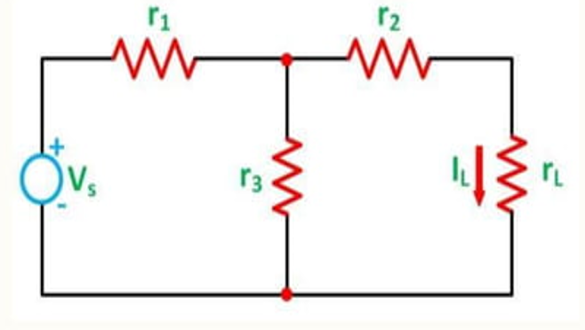
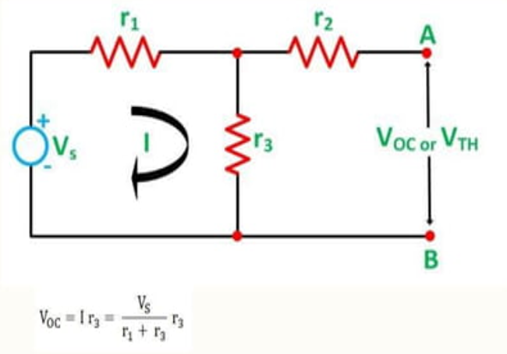

Steps for thevenin
STEP – 1 (Example)
$$≫$$

Slide 9
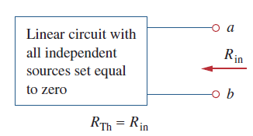
Steps for thevenin
STEP - 2
$$≫$$

Slide 10
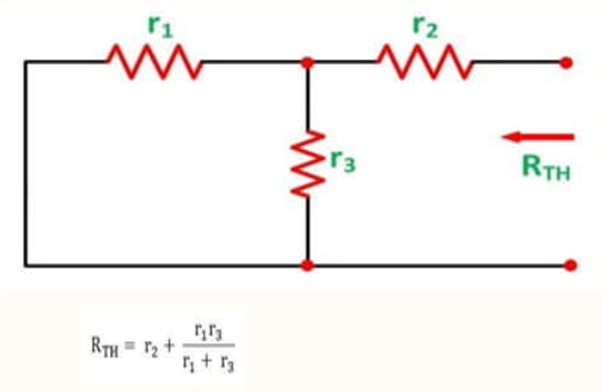
Steps for thevenin
STEP – 2 (Example)
$$≫$$

Slide 11
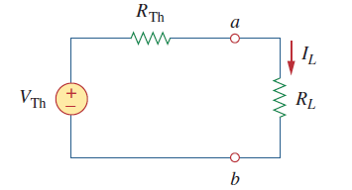
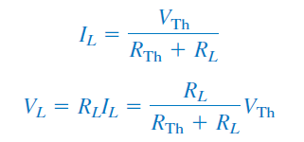
Steps for thevenin
STEP - 3
$$≫$$

Slide 12
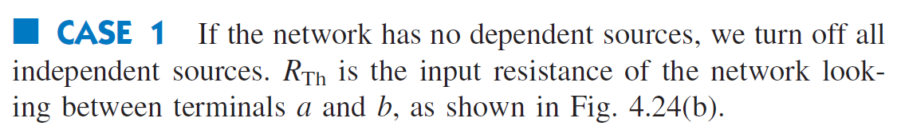
Cases for finding r(Thevenin) or rth

Slide 13
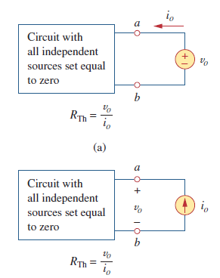
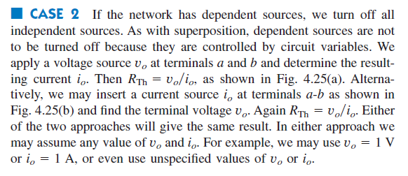
Cases for finding r(Thevenin) or rth (Not included in final)

Slide 14
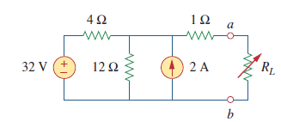

Math Problem Practice:
Reference: Sadiku_Example_4.8

Slide 15

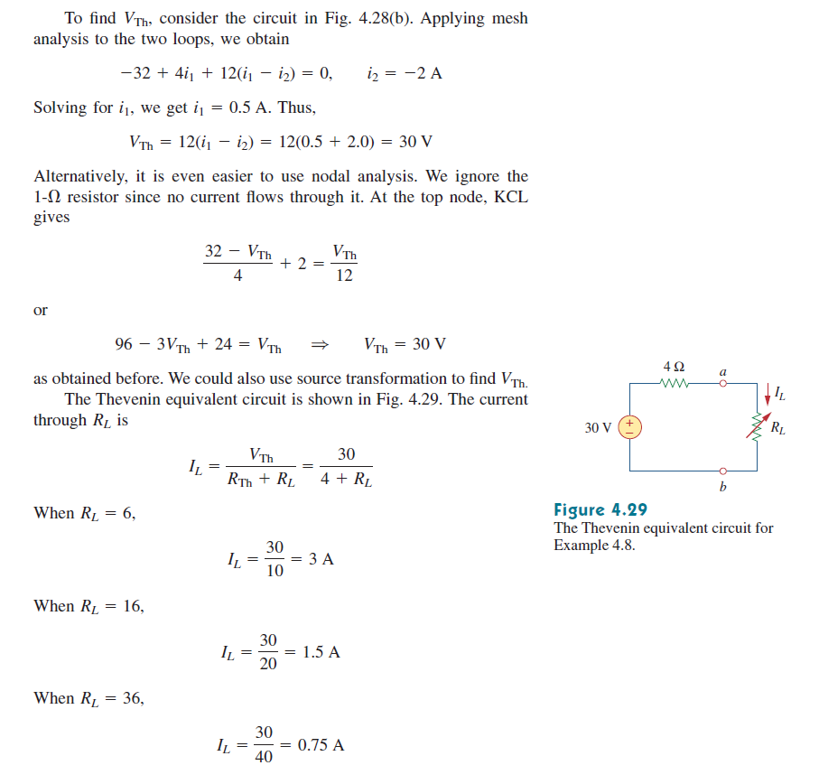
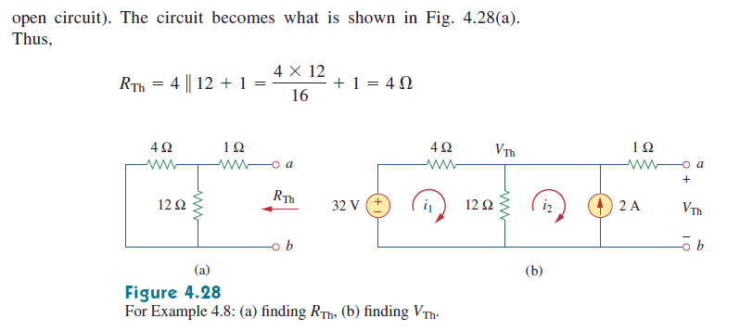
Math Problem Practice:
Reference: Sadiku_Example_4.8

Slide 16
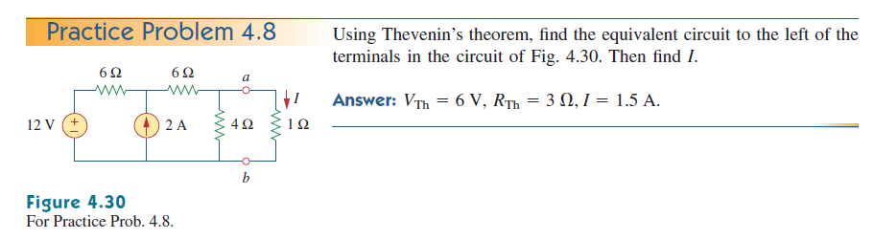
Math Problem Practice:
Reference: Sadiku_Practice_Problem_4.8

Slide 17
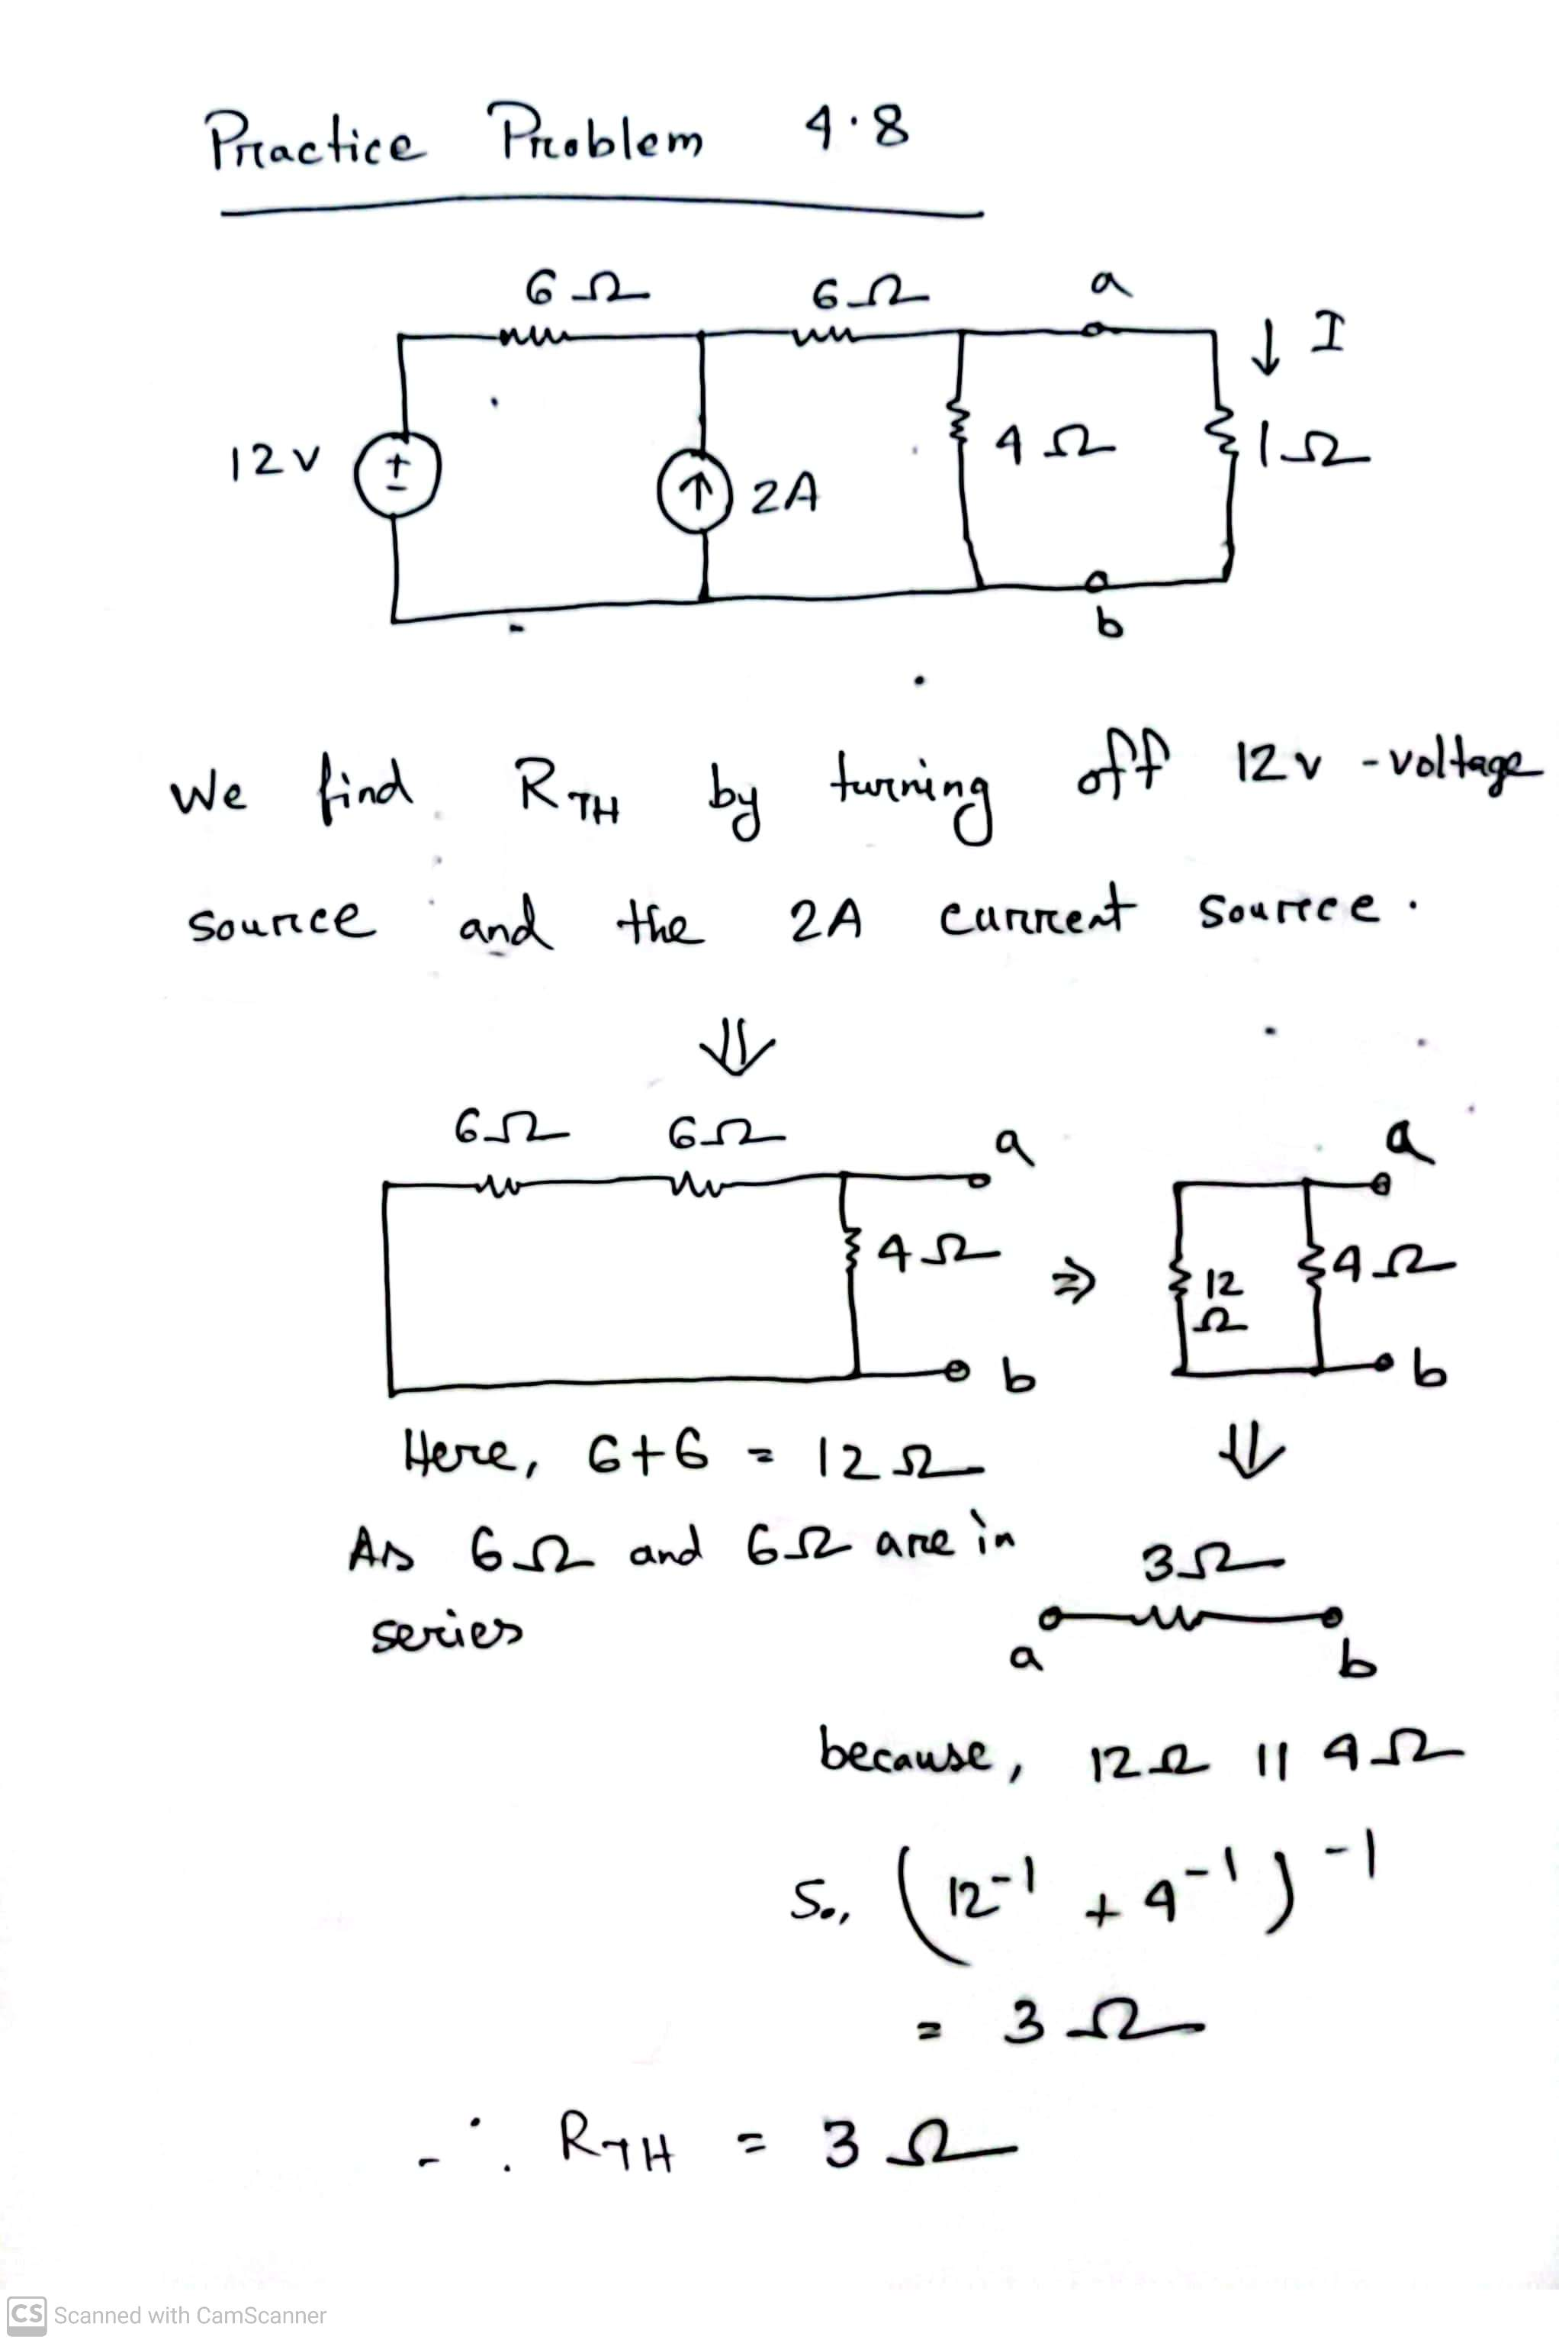
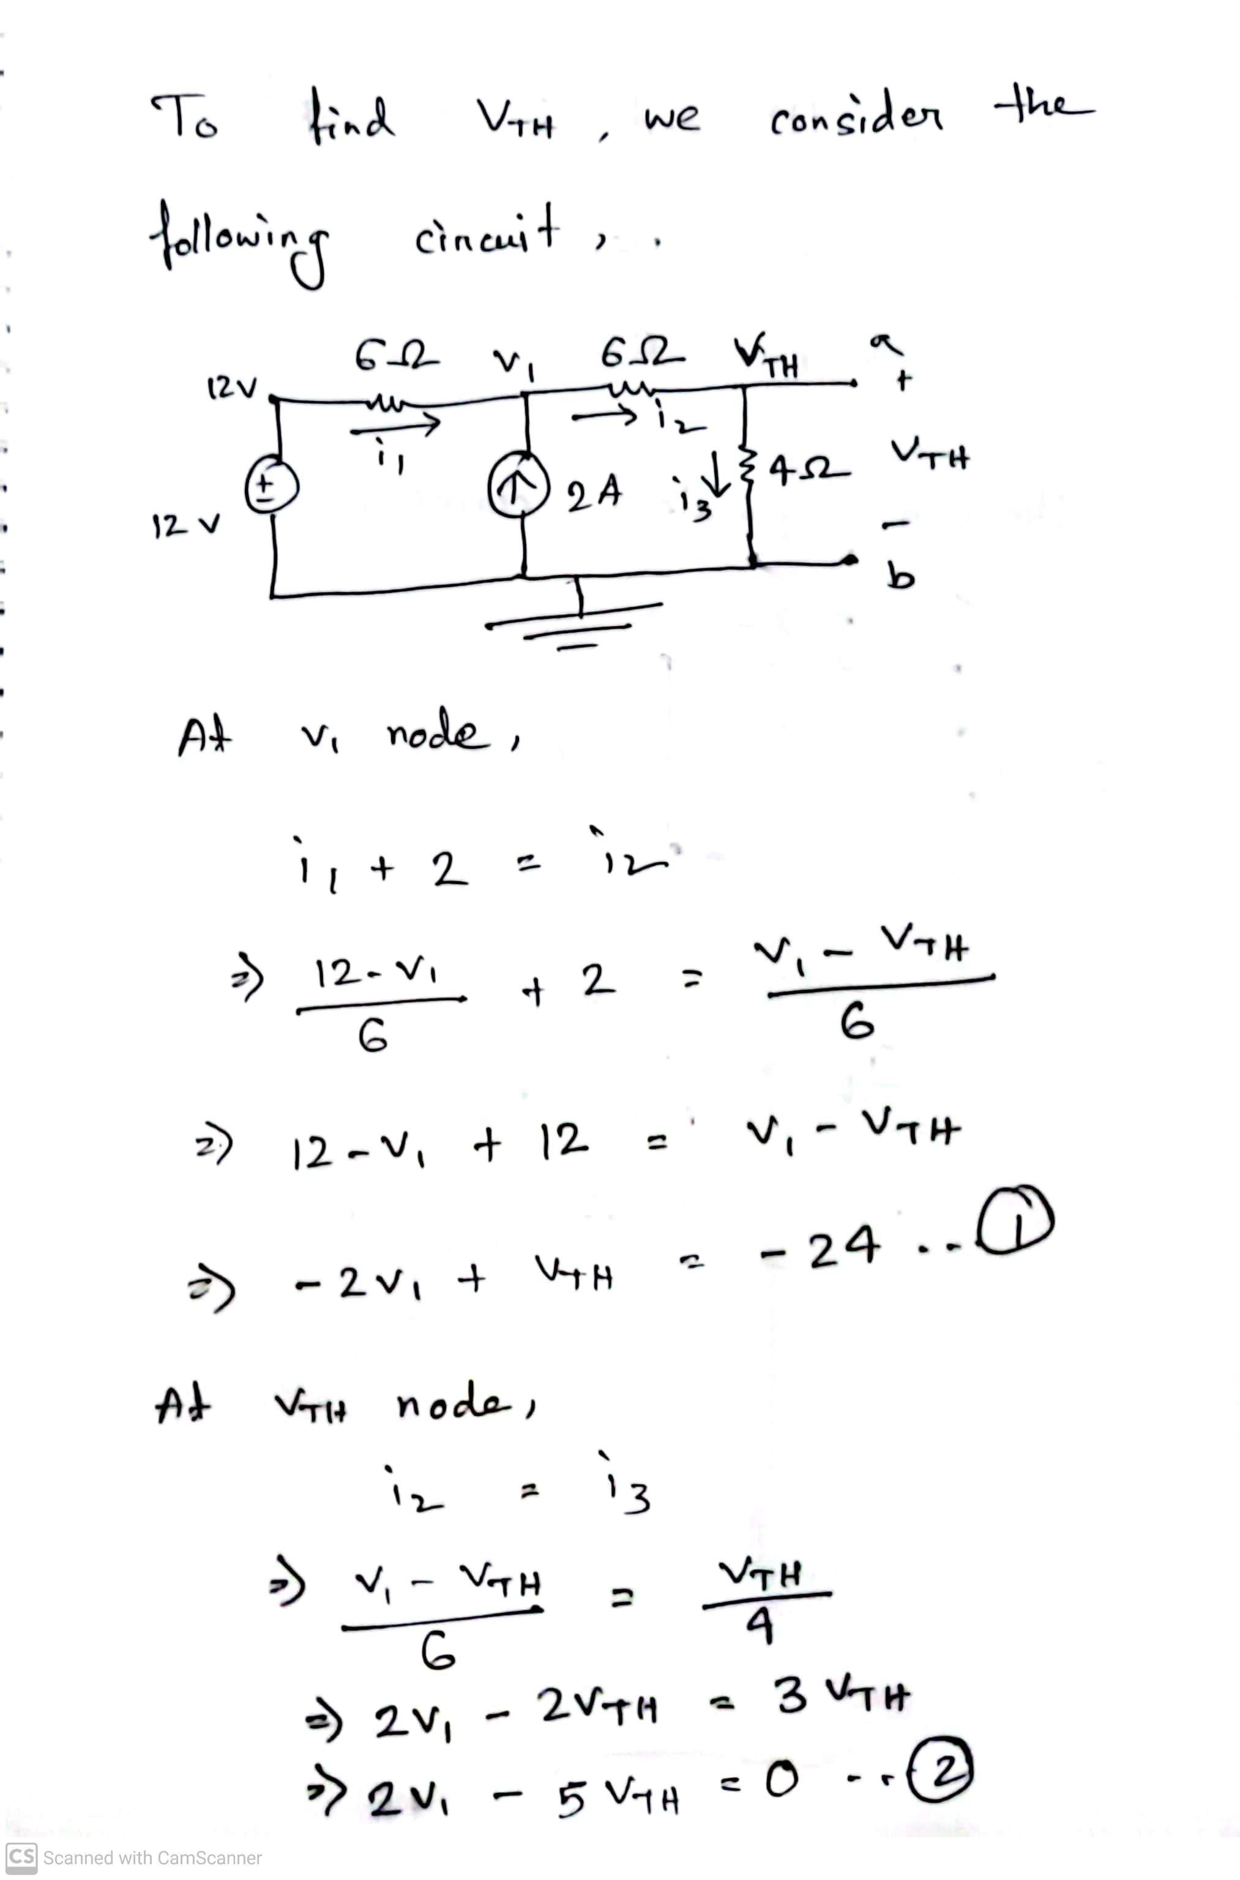
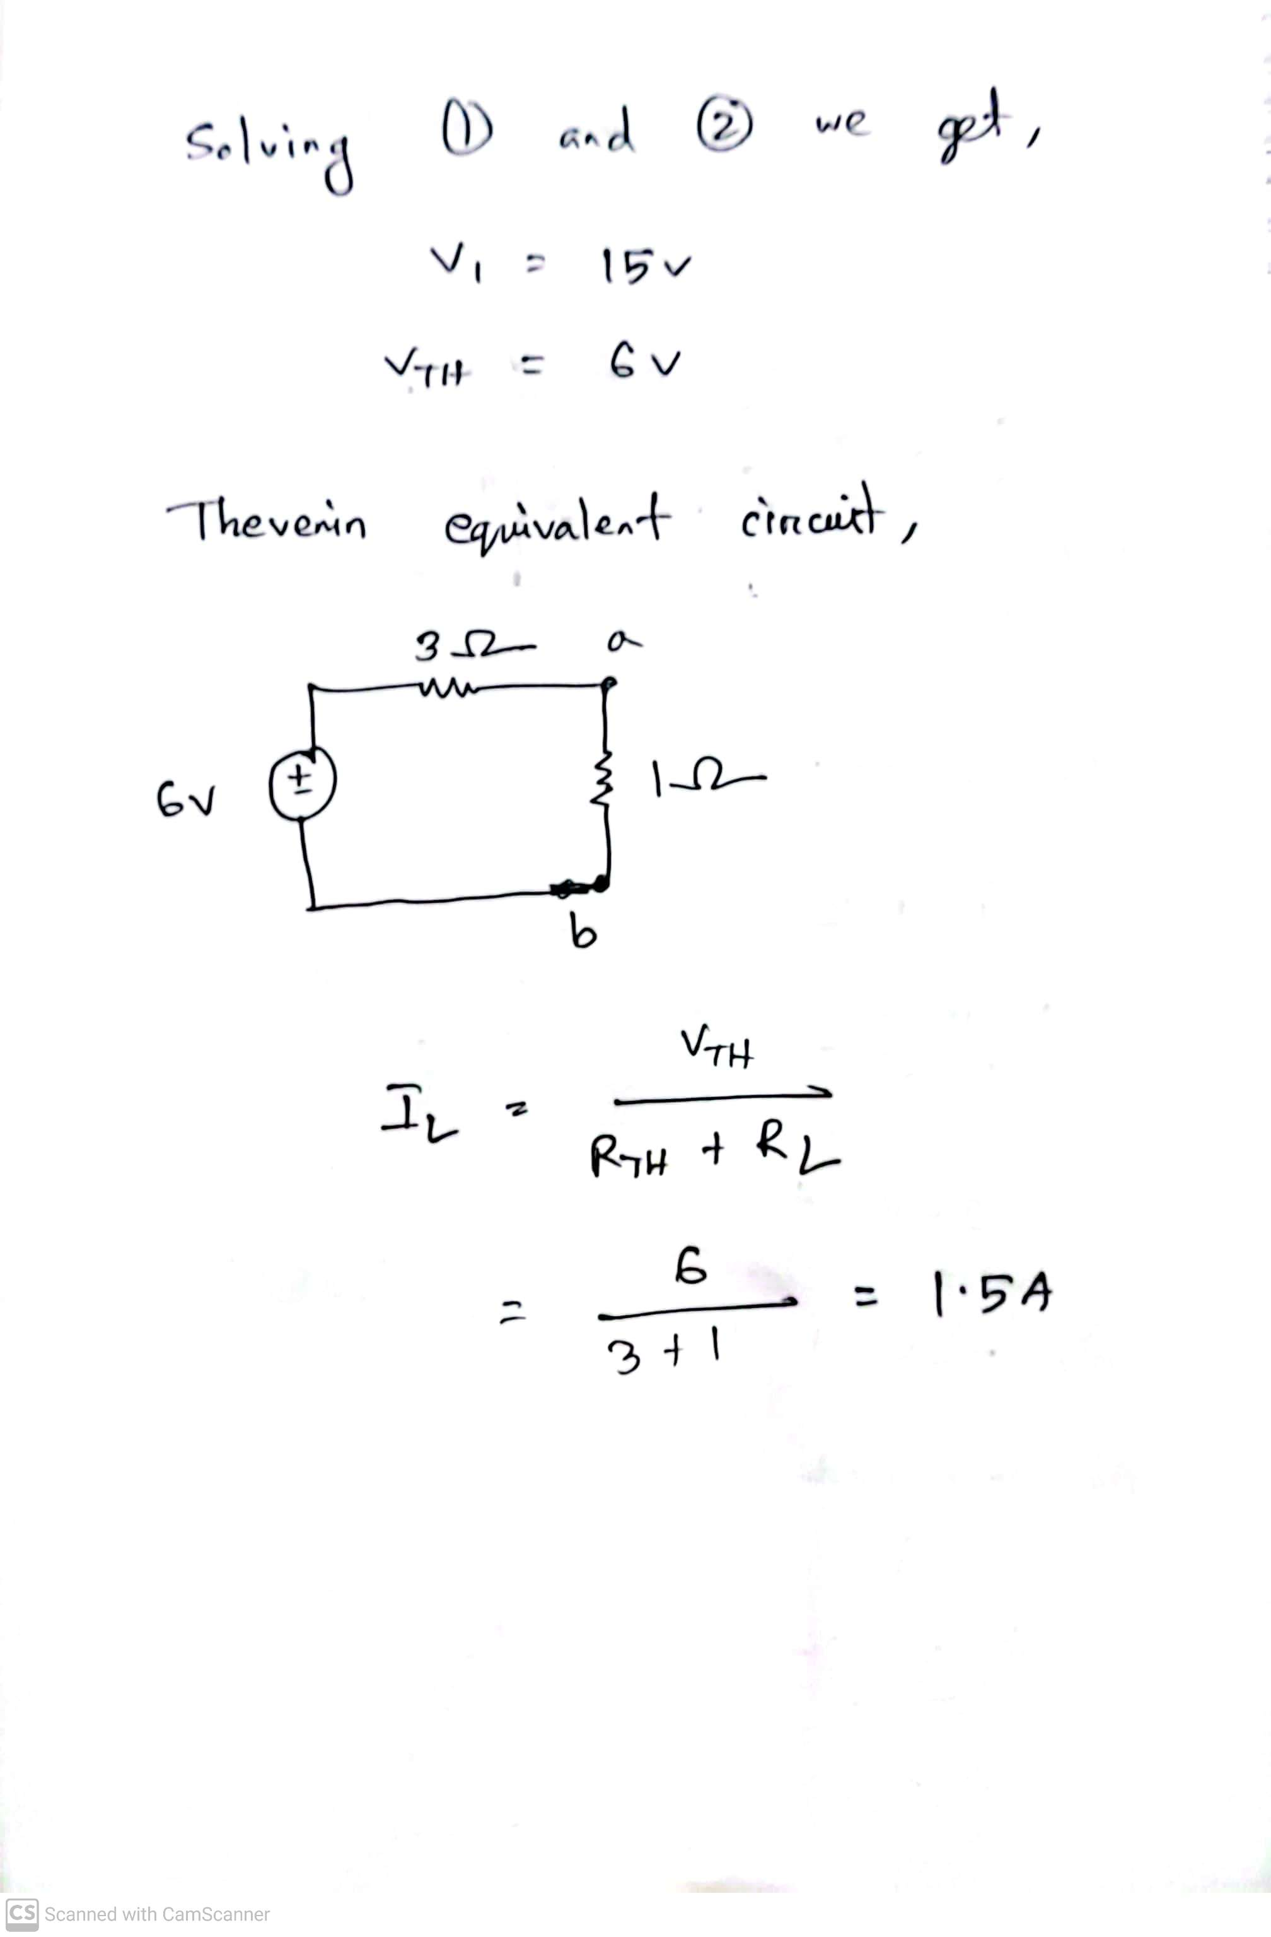
Math Problem Practice:
Reference: Sadiku_Practice_Problem_4.8

Slide 18
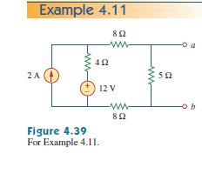
Math Problem Practice:
Find the Thevenin equivalent circuit of the circuit in Fig. 4.39 at terminals a-b.
Reference: Sadiku_Example_4.11

Slide 19
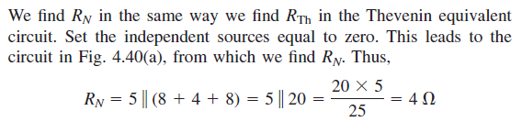
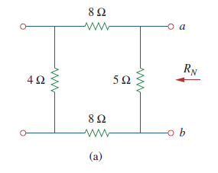
Math Problem Practice:
Reference: Sadiku_Example_4.11

Slide 20
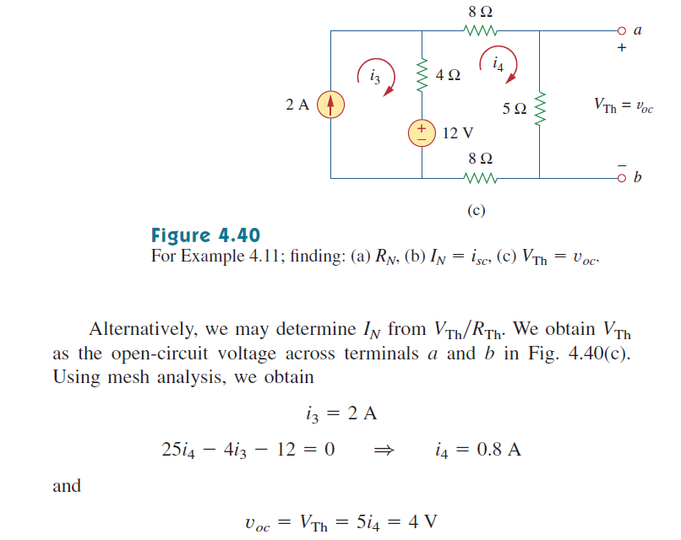
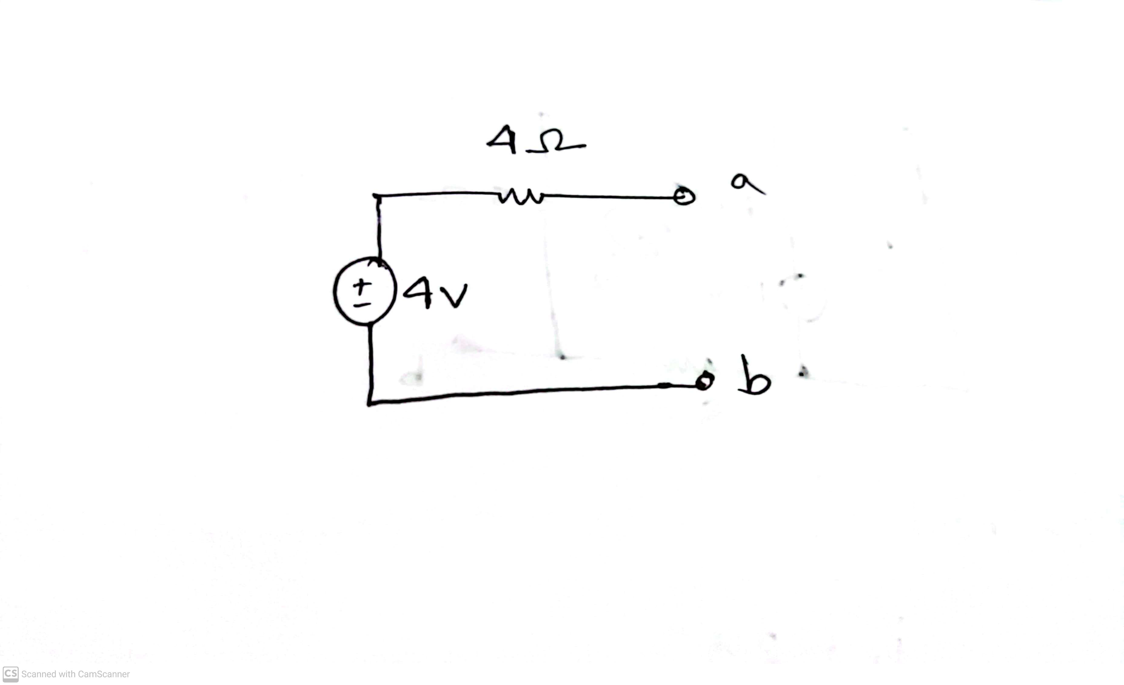
Math Problem Practice:
Reference: Sadiku_Example_4.11

Slide 21
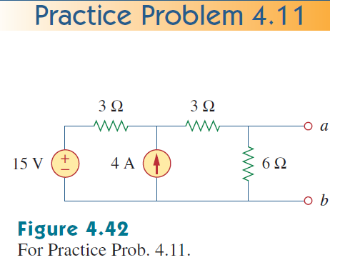
Math Problem Practice:
Find the Thevenin equivalent circuit for the circuit in Fig. 4.42, at terminals a-b.
Reference: Sadiku_Practice_Problem_4.11

Slide 22
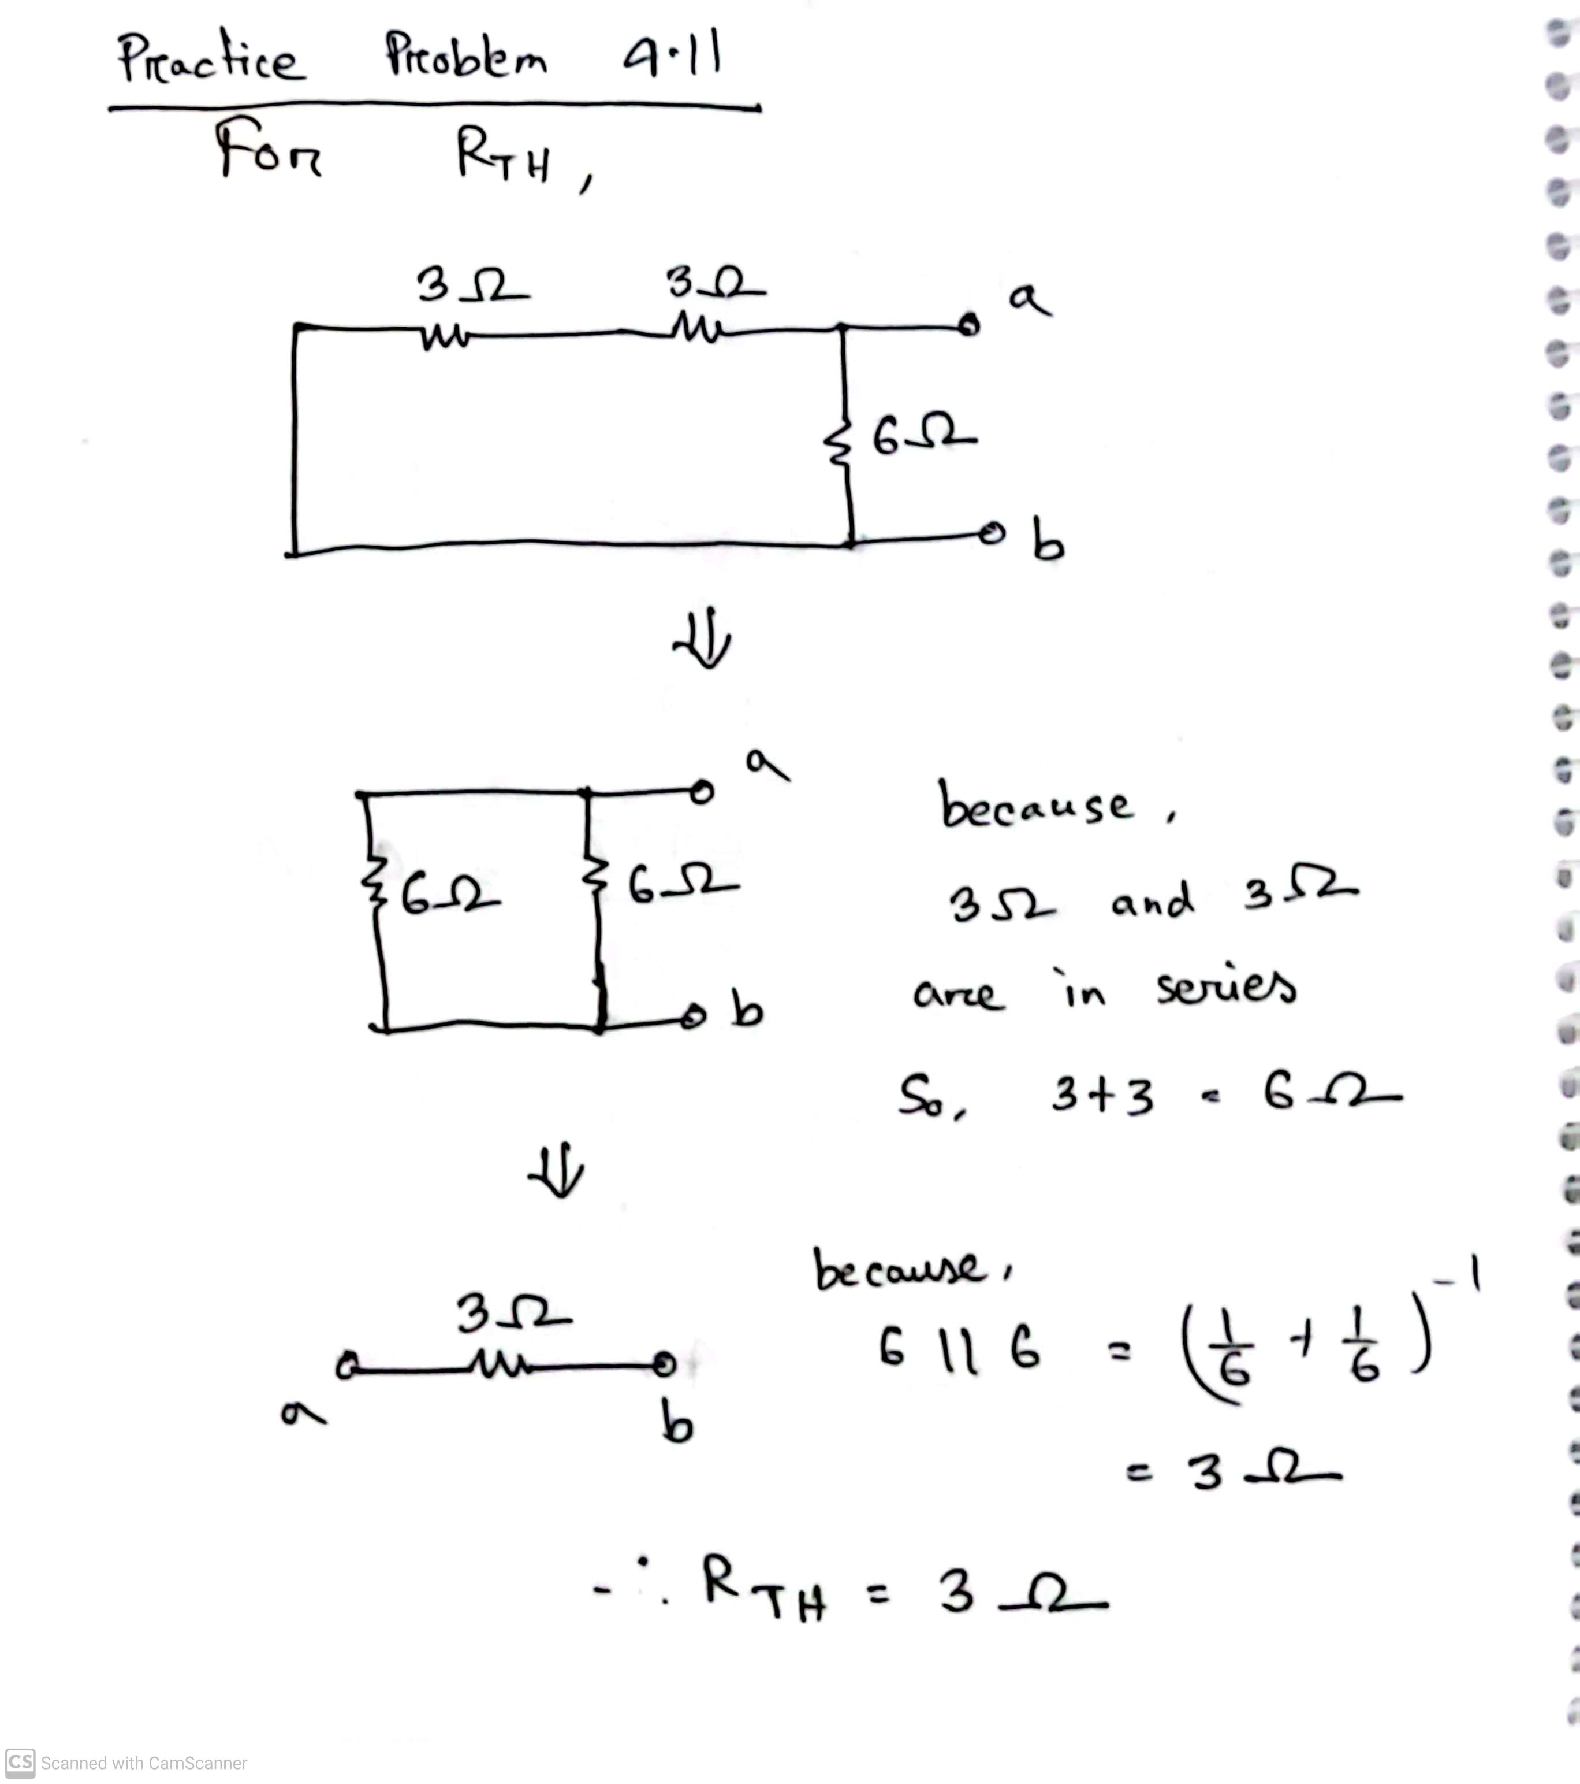
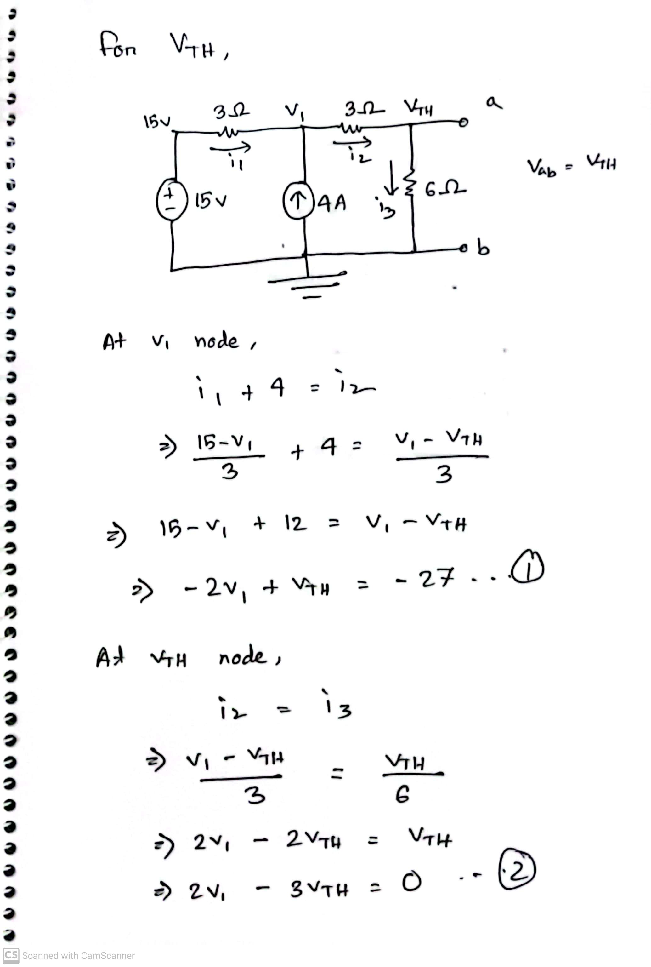
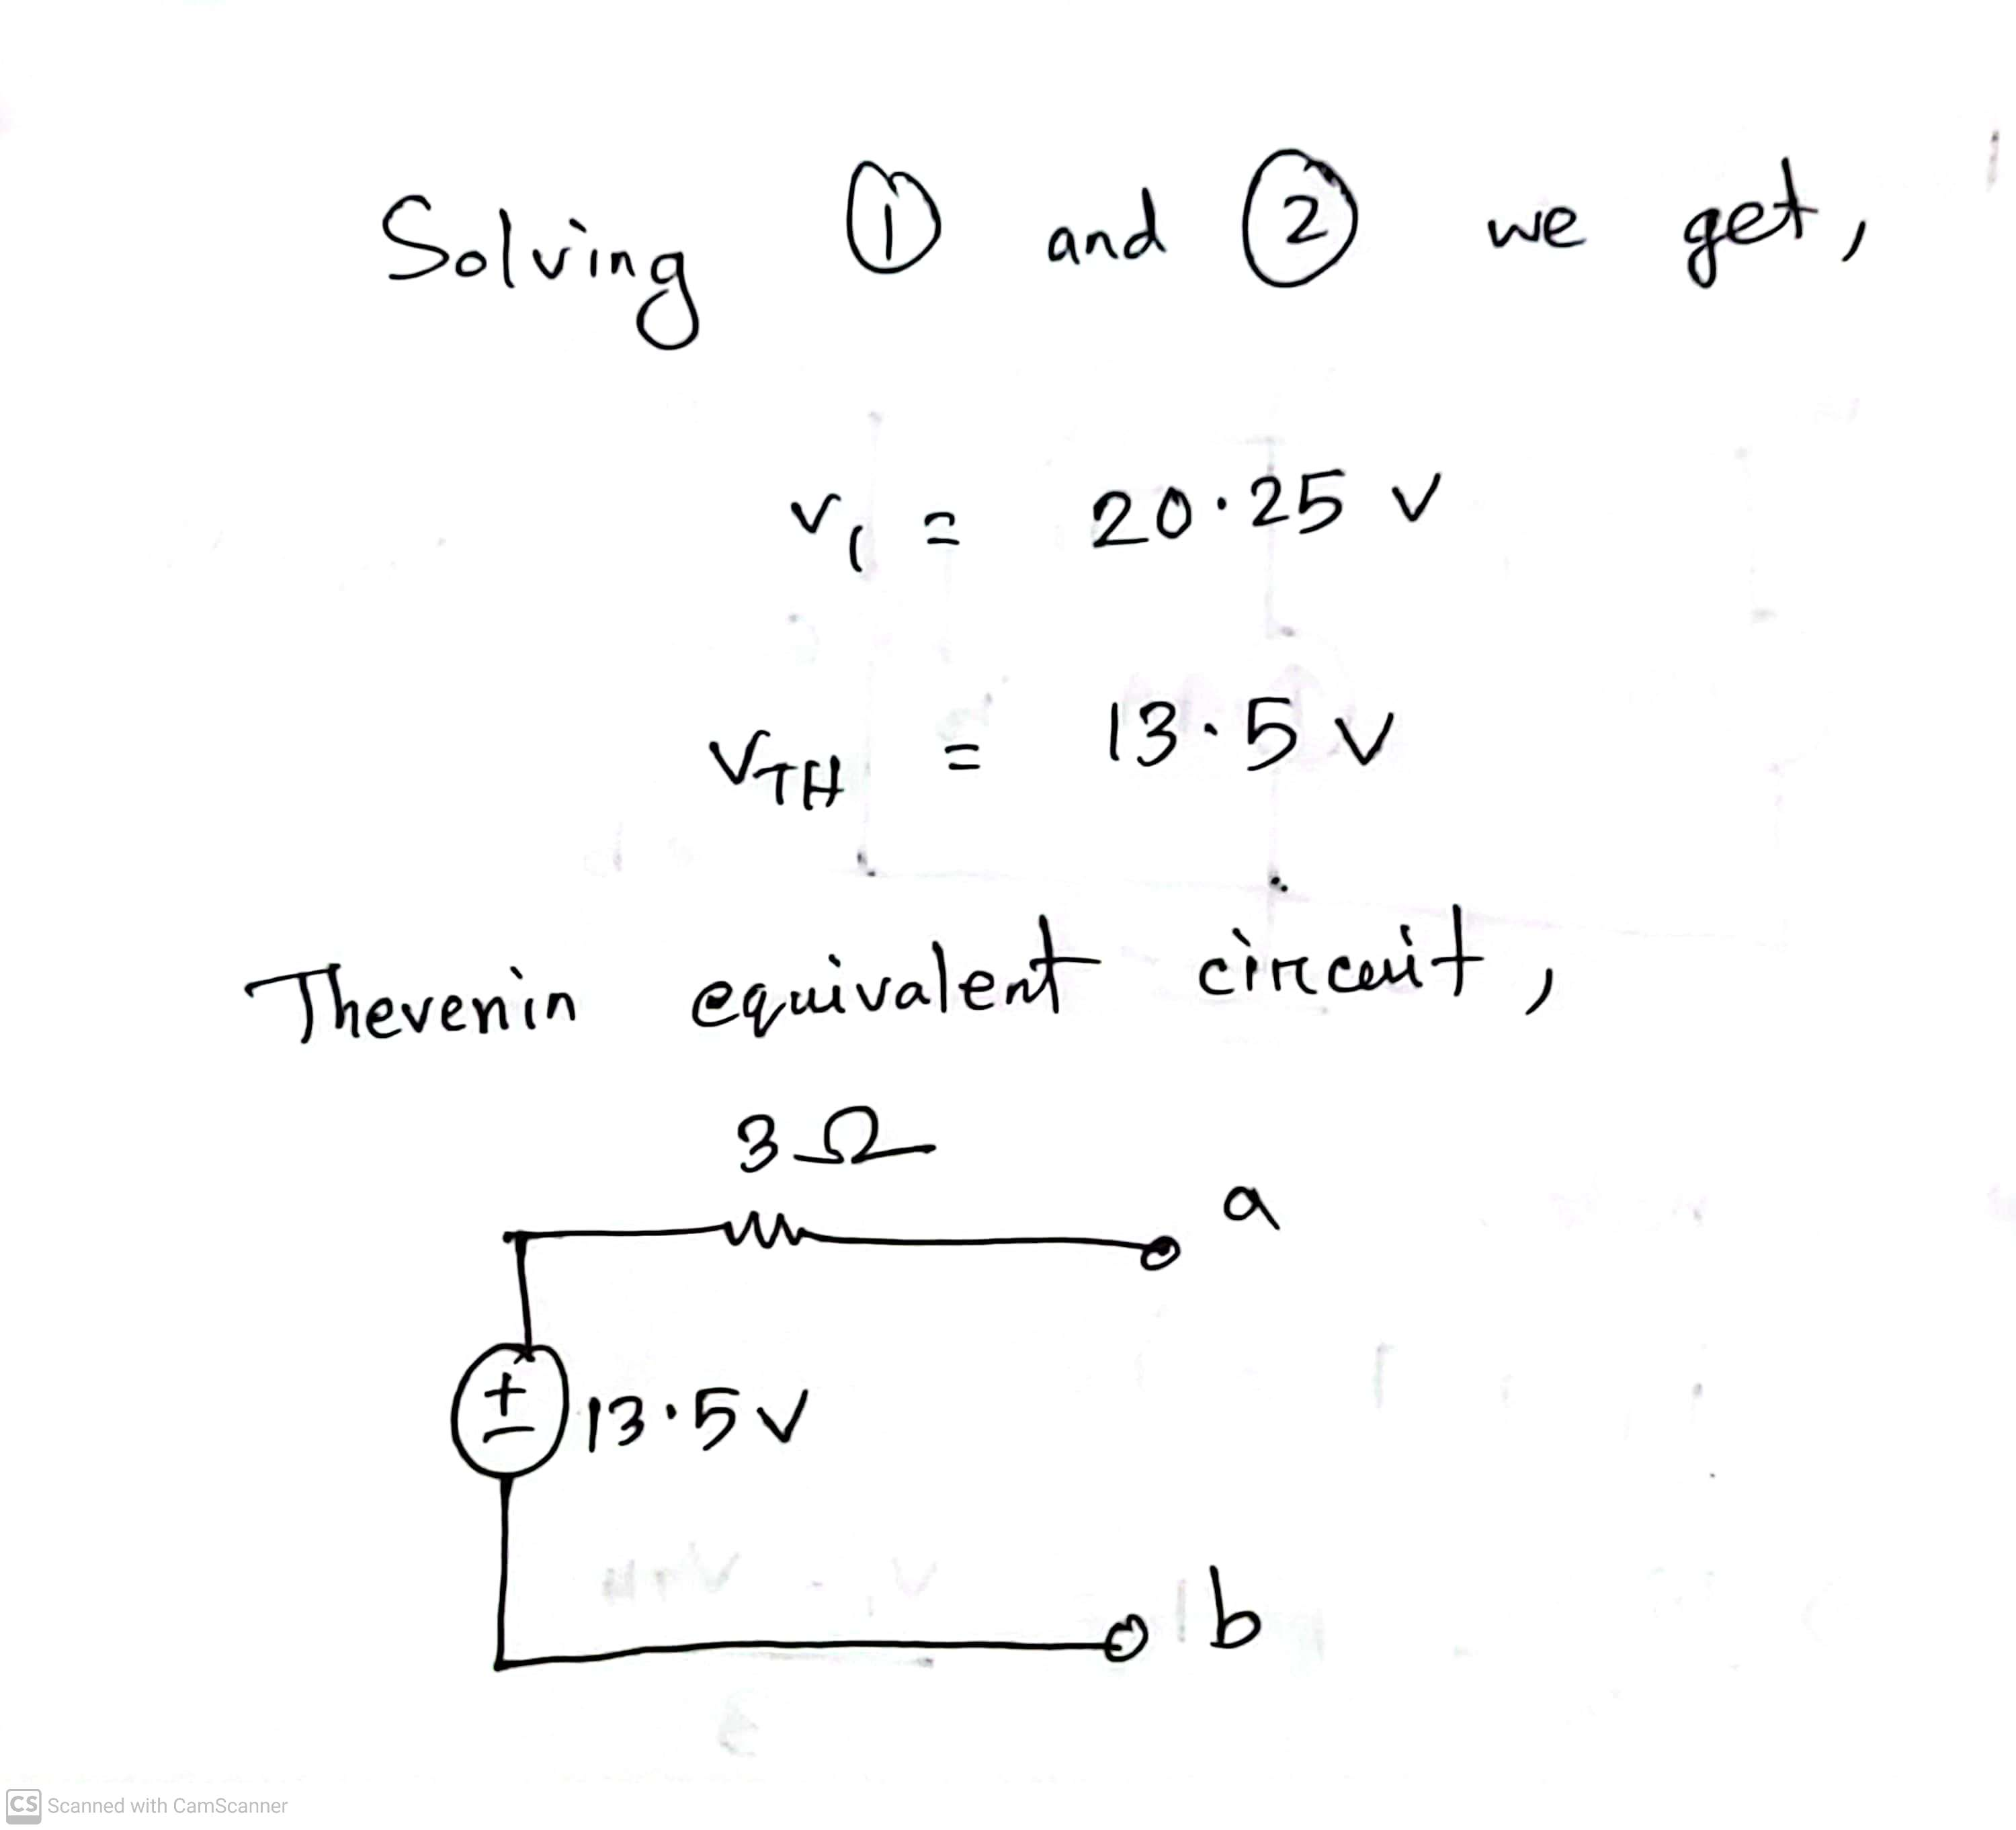
Math Problem Practice:
Reference: Sadiku_Practice_Problem_4.11

Slide 23
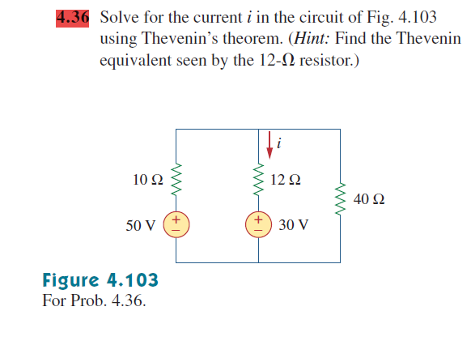
Math Problem Practice:
Reference: Sadiku_Exercise_4.36

Slide 24
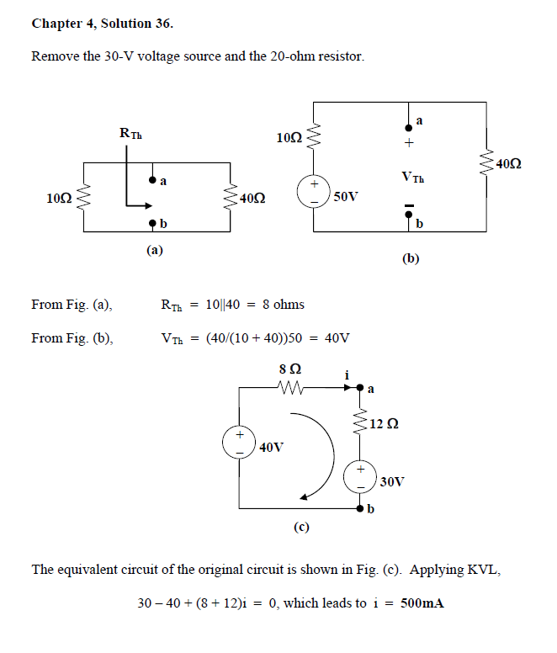
Math Problem Practice:
Reference: Sadiku_Exercise_4.36

Slide 25
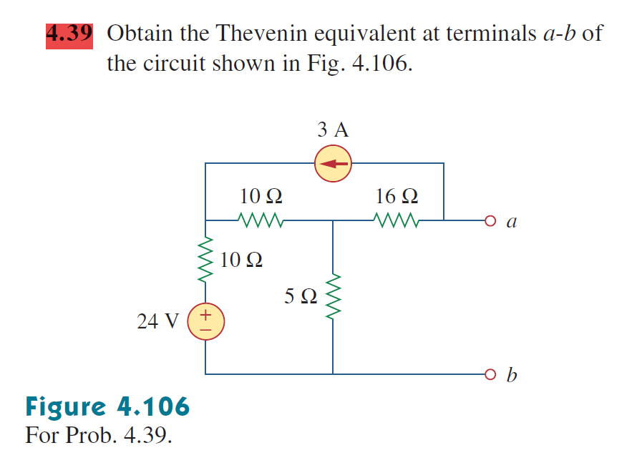
Math Problem Practice:
Reference: Sadiku_Exercise_4.39

Slide 26
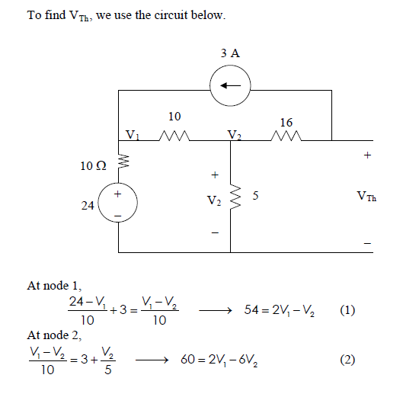
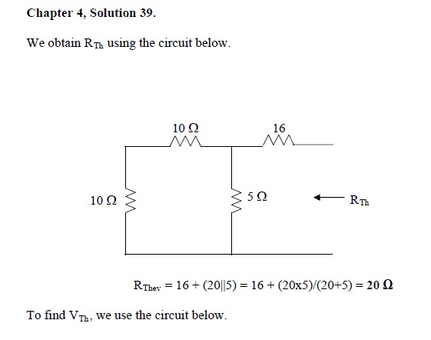
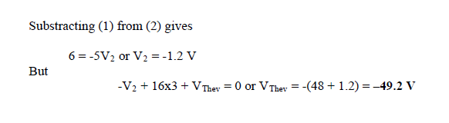
Math Problem Practice:
Reference: Sadiku_Exercise_4.39

Slide 27
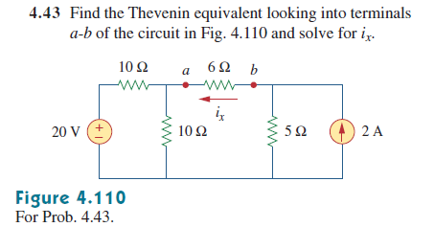
Math Problem Practice:
Reference: Sadiku_Exercise_4.43

Slide 28
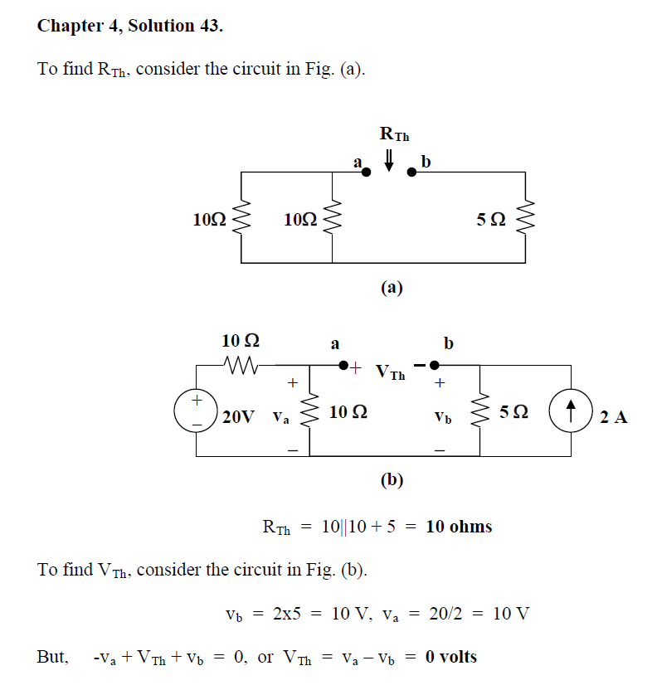
Math Problem Practice:
Reference: Sadiku_Exercise_4.43

Slide 29
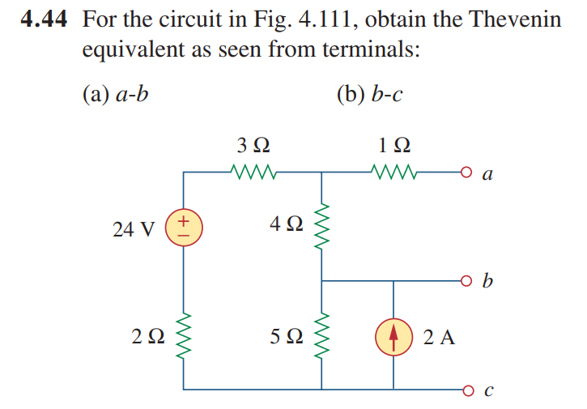
Math Problem Practice:
Reference: Sadiku_Exercise_4.44

Slide 30
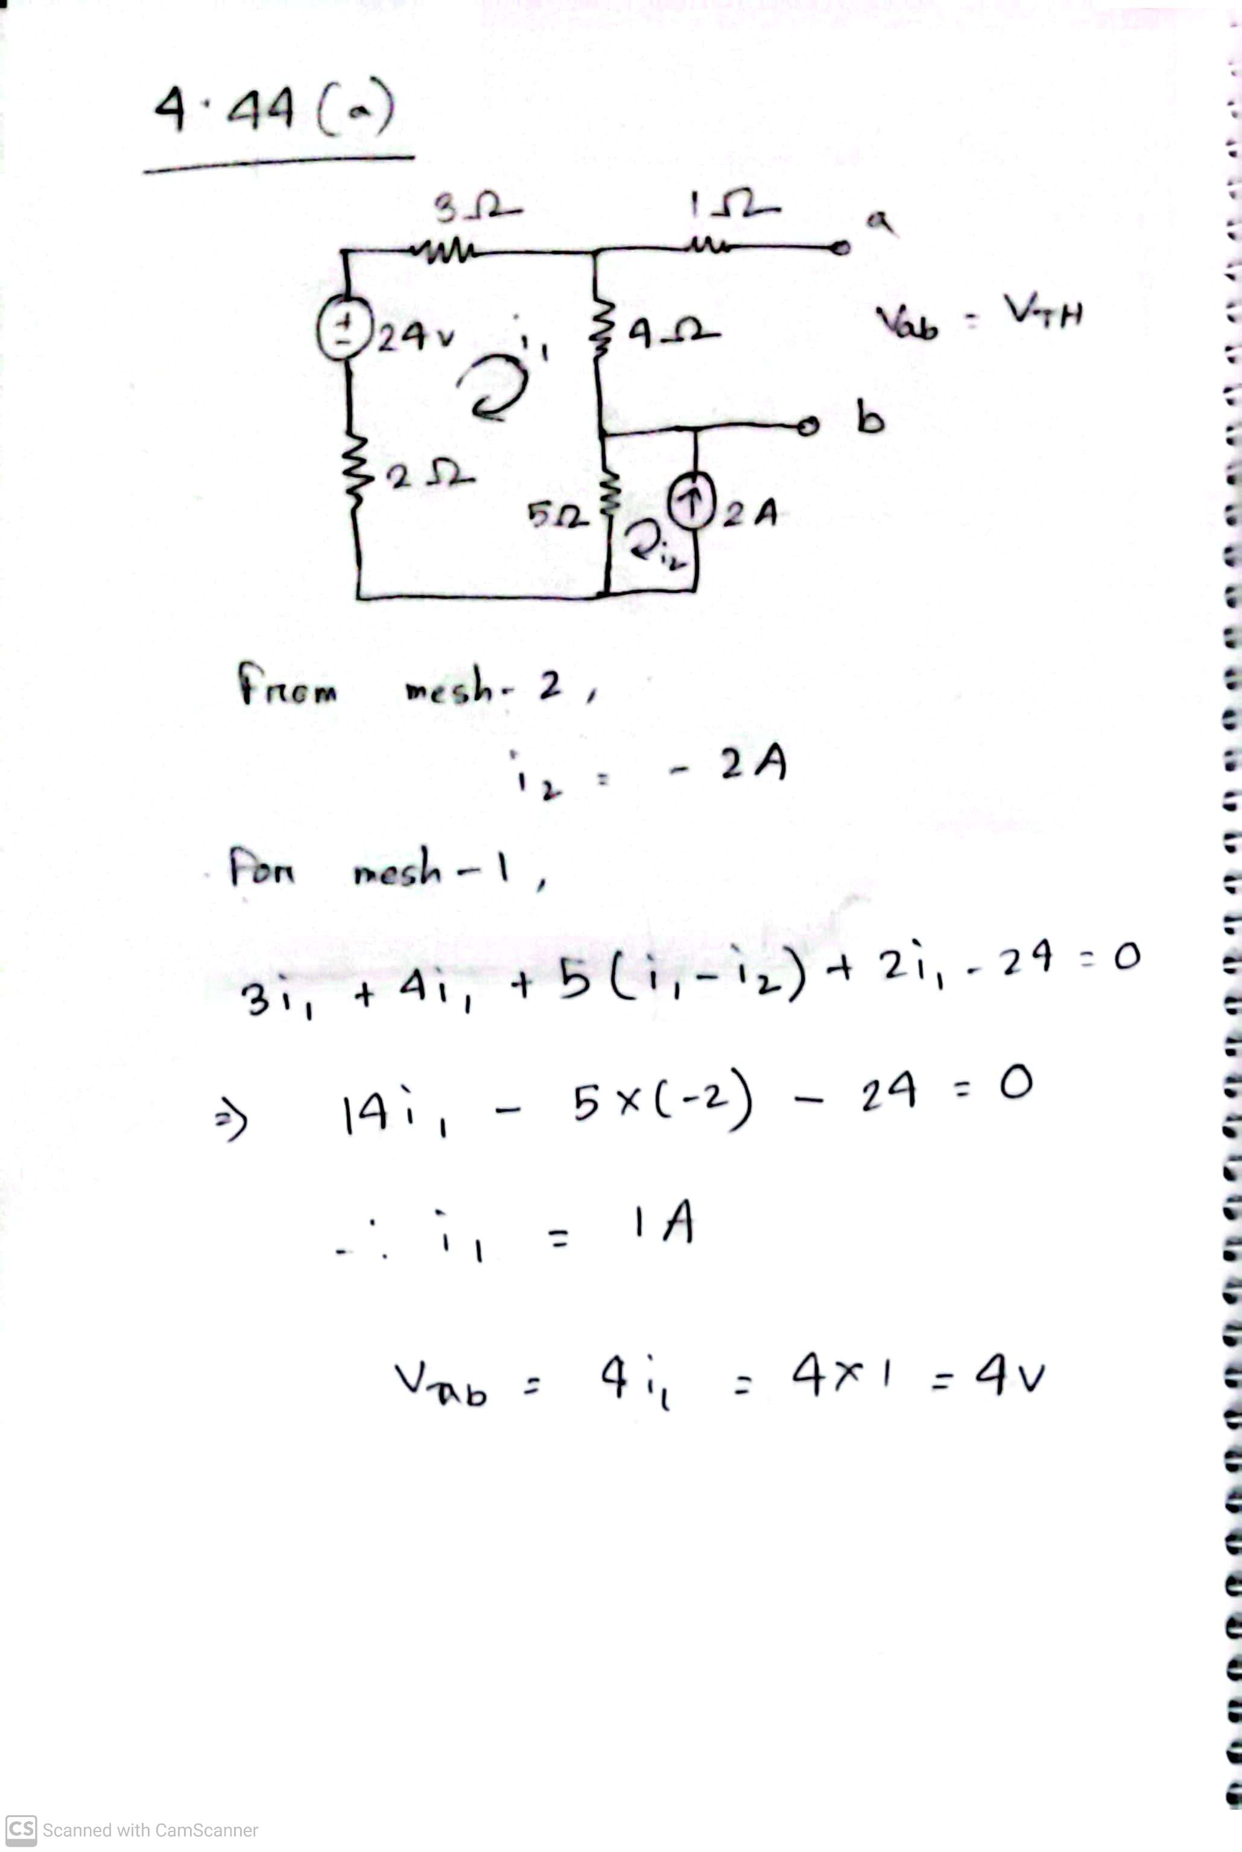
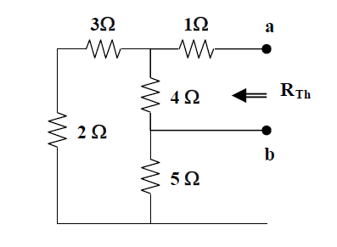
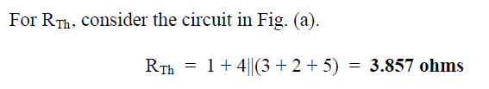
Math Problem Practice:
Reference: Sadiku_Exercise_4.44

Slide 31
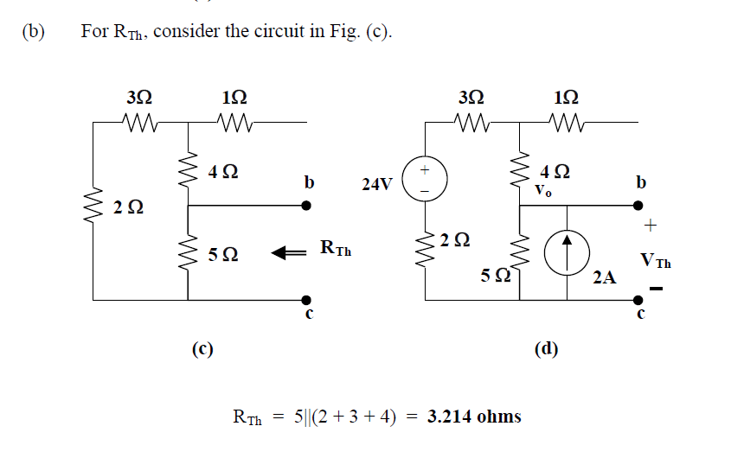
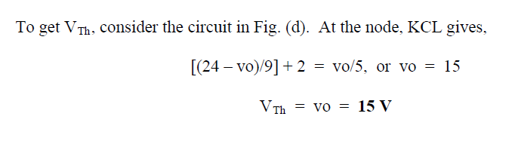
Math Problem Practice:
Reference: Sadiku_Exercise_4.44

Slide 32
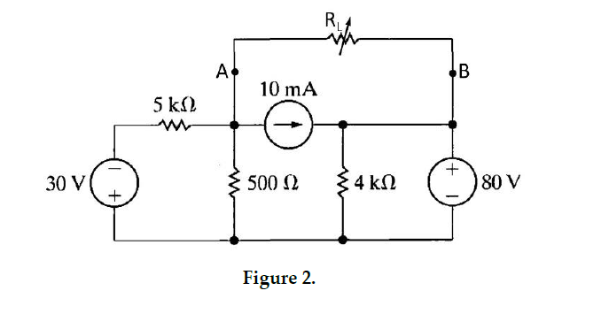
Fall 2023

Slide 33
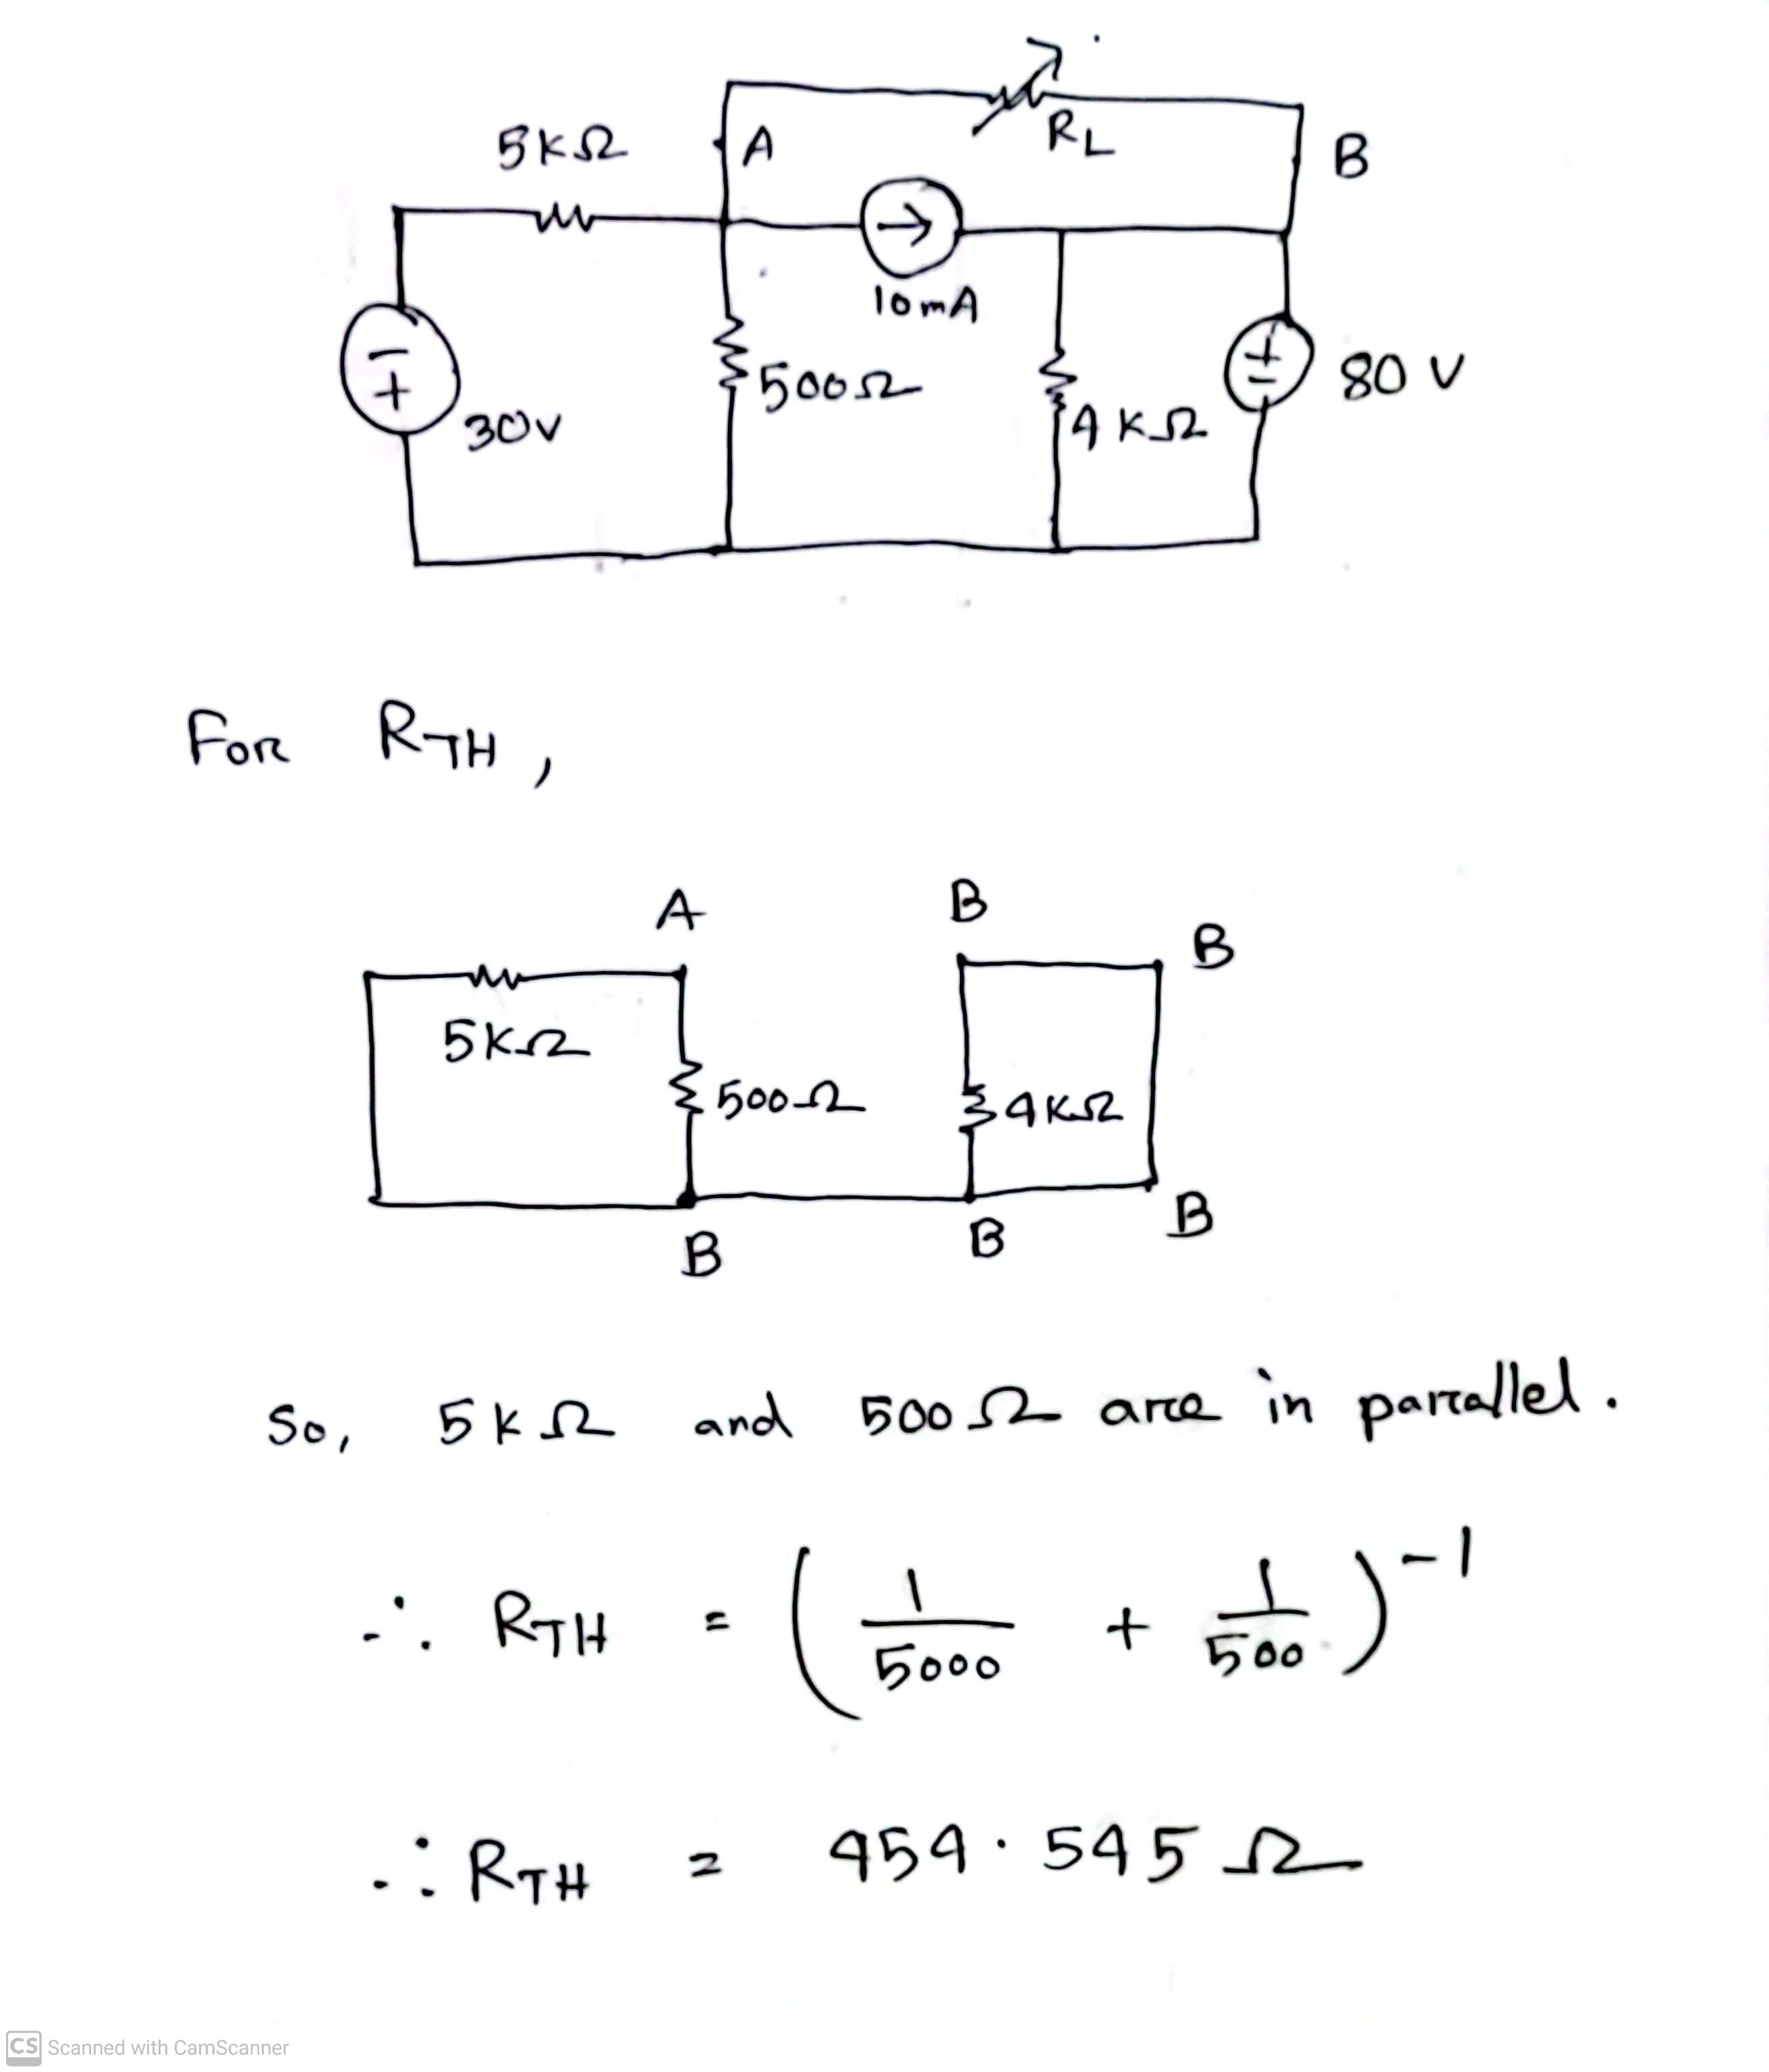
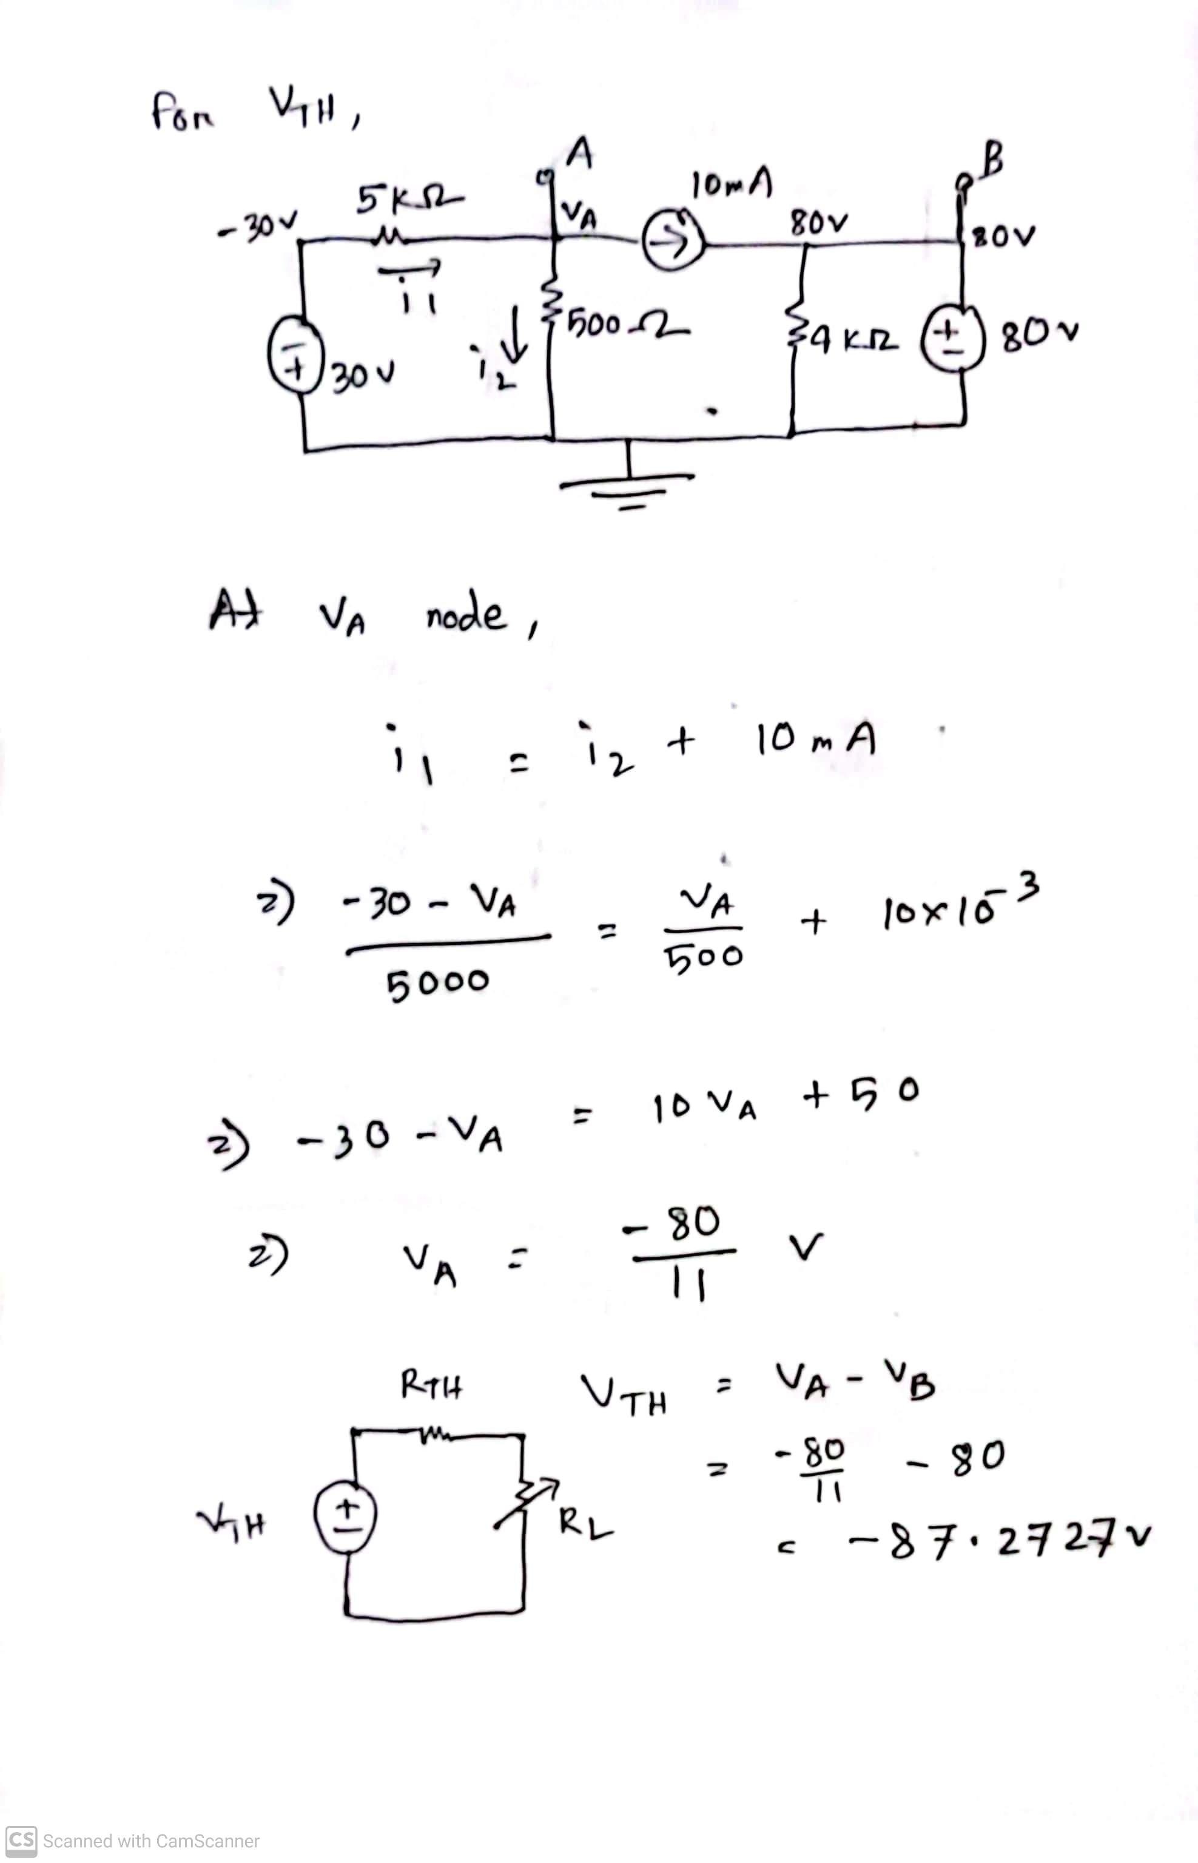
Fall 2023

Slide 34
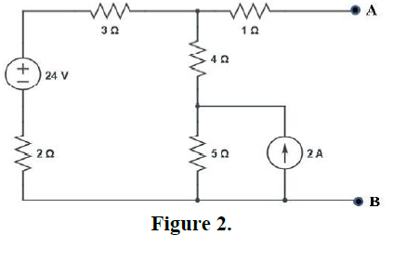
Summer 2023

Slide 35
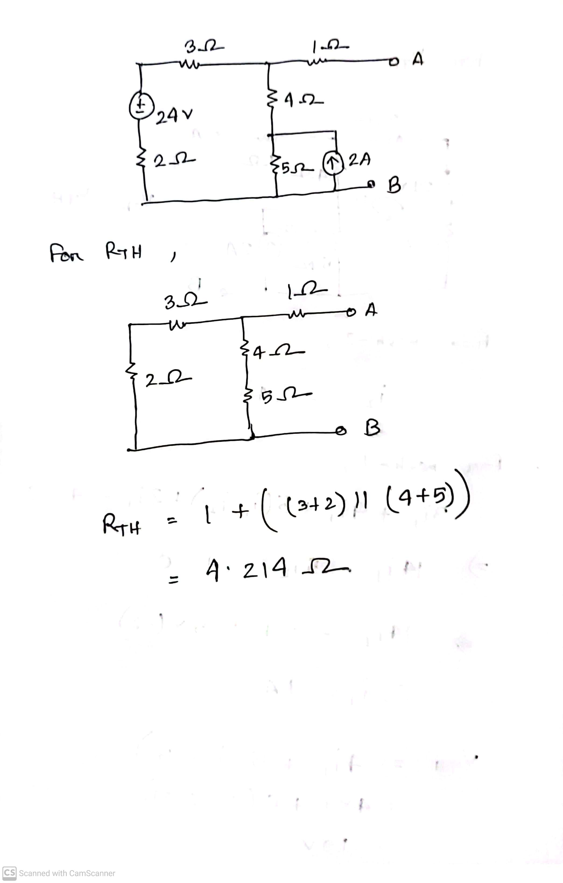

Summer 2023

Slide 36
Short circuit reference
What is SHORT CIRCUIT - Explained with Example | Basics of Electronics (youtube.com)
What is Short Circuit ? Easiest Explanation | TheElectricalGuy (youtube.com)
The Concept of Short Circuit (youtube.com)

Slide 37
Math to Practice from the Book for Exam
Thevenin’s Theorem:
Example:
4.8, 4.11
Practice Problem:
4.8, 4.11
Problem:
4.36, 4.37, 4.38, 4.39, 4.41, 4.43, 4.44, 4.50(**), 4.51(**), 4.56, 4.59, 4.60, 4.61(***), 4.66
N:B: Please note that Circuits with Independent sources only, for Thevenin’s theorem!

Slide 38
Thank you

